Slide 1
Thermal Measurements using Portable Charger

Slide 2
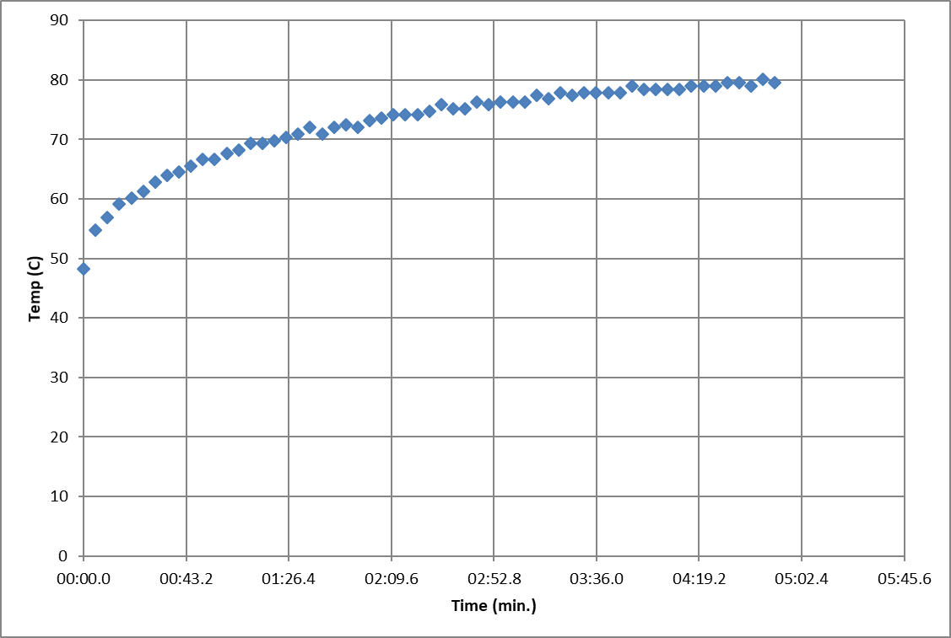
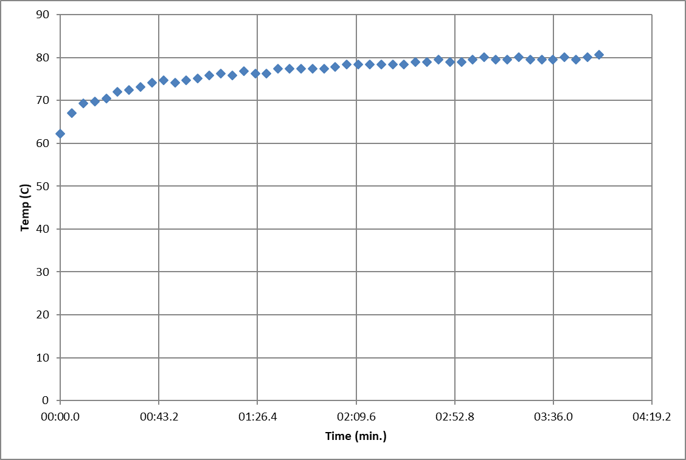
Temperature of RPi over 5 minute interval

Slide 3
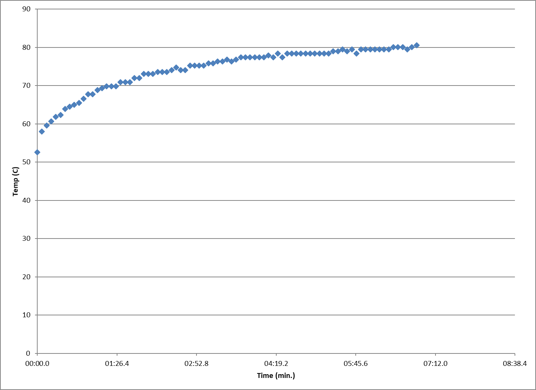
Temperature of RPi over 10 minute interval

Slide 4
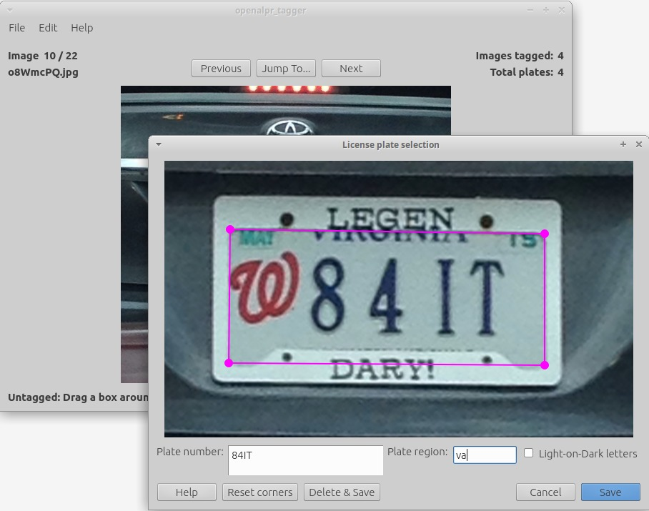
openALPR plate detection training
Train-detector
OpenALPR Plate Tagger
Tags images with license plate locations
Images can then be used with train-detector to train OpenALPR algorithm
Collect 100s to 1000s of positive images to train detector
Input height, width, and country of license plates

